Slide 1
Food Delivery Website
Task - 3

Slide 2

Food Devlivery Website
LMS Username | Name | Batch
2115a827 | RANJITH V | A8_13
2115a84 | DEEPAKRAJAN R | A8_13
2115a822 | MOHAMMED JAMALUDDIN S | A8_13
2115a844 | SUNDAR K | A8_13

Slide 3
SOURCE CODE
Main.html
<!DOCTYPE html>
<html lang="en">
<head>
<meta charset="UTF-8">
<meta http-equiv="X-UA-Compatible" content="IE=edge">
<meta name="viewport" content="width=device-width, initial-scale=1.0">
<title>Fastest Delivery</title>
<link rel="stylesheet" href="style.css">
<link rel="preconnect" href="https://fonts.googleapis.com">
<link rel="preconnect" href="https://fonts.gstatic.com" crossorigin>
<link href="https://fonts.googleapis.com/css2?family=Public+Sans:wght@300&display=swap" rel="stylesheet">
<link rel="icon" href="foodie.png" type="image/png/gif">
<link rel="stylesheet" href="https://cdn.jsdelivr.net/npm/bootstrapicons@1.10.3/font/bootstrap-icons.css">
</head>

Slide 4
<body>
<div class="header">
<div class="navigation">
<nav>
<ul class="navimg">
<img src="foodie.png" id="logo" alt="error loading image">
<ul class="navbar">
<li><a href="#">Home</a></li>
<li><a href="about.html">About</a></li>
<li><a href="#Services">Services</a></li>
<li><a href="#cus">Contact Us</a></li>
</ul>
</ul>
</nav>
</div>
</div>
<div class="title">
<h1>WELCOME TO FOODIE!</h1>
<h2>The Fastest Food Delivery Service in India.</h2>
<h3 class="button">ORDER NOW</h3></div>

Slide 5
<main id="Services">
<h2>Services</h2>
<section>
<div>
<img class="mainimage" src="pizza.jpg" alt="error loading image">
<h3>Fast Foods</h3>
<p>
You can now get delivery from your favorite fast food restaurants with ease.
If you’re wondering how all this works, keep reading. This article will walk you through everything you need
to know about fast food delivery,including what kind of fast food you can get delivered, where fast
food delivery is available, and how to make it all happen.
</p>
<h3 class="button" id="btn1">ORDER NOW</h3>
</div>
<div>
<img class="mainimage" src="veg.jpg" alt="error loading image">
<h3>Fresh Vegetables</h3>

Slide 6
<p>
Like other grocery delivery services, produce delivery services ship food straight
to your door. But unlike some other services, they typically limit their offerings to fresh vegetables.
These services are a great way to save money on fresh food, try new and seasonal produce,
and save time on grocery shopping.
</p>
<h3 class="button" id="btn2">ORDER NOW</h3>
</div>
</section>
</main>
<div id="cus" class="contactus">
<h2>Contact Us</h2>
<section>
<form action="backend.php">
<h3>
We are always ready to help you!
</h3>
<div>
<input type="text" class="formcss" name="myname" placeholder="Name">
</div>

Slide 7
<div>
<input type="email" class="formcss" name="myemail" placeholder="foodie@gmail.com">
</div>
<div>
<input type="number"class="formcss" name="mycontact" placeholder="Contact Number">
</div>
<div>
<input type="submit" class="btnsm" value="Submit">
<input type="reset" class="btnsm" value="Reset">
</div>
</form>
</section>
</div>
<footer>
<h3>&copy; Foodie | All Rights Reserved</h3>
<p><i id="insta" class="bi bi-instagram"></i><i id="twitter" class="bi bi-twitter"></i><i id="facebook"
class="bi bi-facebook"></i><i id="whatsapp" class="bi bi-whatsapp"></i></p>
</footer>
</body>
</html>

Slide 8
About.html
<!DOCTYPE html>
<html lang="en">
<head>
<meta charset="UTF-8">
<meta http-equiv="X-UA-Compatible" content="IE=edge">
<meta name="viewport" content="width=device-width, initial-scale=1.0">
<title>Fastest Delivery</title>
<link rel="stylesheet" href="style.css">
<link rel="preconnect" href="https://fonts.googleapis.com">
<link rel="preconnect" href="https://fonts.gstatic.com" crossorigin>
<link href="https://fonts.googleapis.com/css2?family=Public+Sans:wght@300&display=swap" rel="stylesheet">
<link rel="icon" href="foodie.png" type="image/png/gif">
<link rel="stylesheet" href="https://cdn.jsdelivr.net/npm/bootstrap-icons@1.10.3/font/bootstrap-icons.css">
<script src="https://cdn.tailwindcss.com"></script>
</head>
<body>
<div class="head">
<div class="navigation">
<nav>

Slide 9
<ul class="navimg">
<img src="foodie.png" id="logo" alt="error loading image">
<ul class="navbar">
<li><a href="index.html">Home</a></li>
<li><a href="#">About</a></li>
<li><a href="index.html#Services">Services</a></li>
<li><a href="index.html#cus">Contact Us</a></li>
</ul>
</ul>
</nav>
</div>
</div>

Slide 10
Style.css
body
{
font-family: 'Public Sans', sans-serif;
margin: 0;
padding: 0;
}
.navigation
{
position: fixed;
background-color:#202523;
opacity: 0.9;
width: 100vw;
margin: 0;
padding: 0;
display: flex;
flex-wrap: wrap;
}
.header::before
{
background: url('navback.jpg') no-repeat center center/cover;

Slide 11
content: "";
position: absolute;
top: 0;
left: 0;
width: 100%;
height: 700px;
z-index: -1;
opacity: 0.8;
}
.navimg
{
display: flex;
flex-wrap: wrap;
align-items: center;
margin: 0;
padding: 0;
}
#logo
{
padding-right: 10px;

Slide 12
padding-left: 10px;
width: 53px;
}
.navbar
{
padding: 10px;
display: flex;
flex-wrap: wrap;
}
.navbar li
{
font-size: 1.3rem;
margin-right: 15px;
list-style: none;
}
.navbar li a
{
color: rgb(255, 255, 255);
text-decoration: none;
}

Slide 13
.navbar li a:hover
{
text-decoration: underline;
}
@media (min-width:100px) and (max-width:447px)
{
.navigation
{
align-items: center;
}
#logo
{
width: 60px;
display: block;
margin: auto;
}
.navbar {
padding: 0;
width: 100vw;

Slide 14
display: flex;
justify-content: center;
}
.navbar li
{
margin-left: 10px;
margin-right: 10px;
}
}
.title
{
padding:0;
margin:0;
height:700px;
display:flex;
flex-direction: column;
align-items:center;
justify-content: center;
}

Slide 15
.title h1
{
padding-left:15px;
padding-right:15px;
margin:0;
color:white;
font-size:4rem;
text-shadow: 5px 5px 9px black;
animation-name:title;
animation-duration: 1s;
animation-iteration-count: 1;
animation-fill-mode: forwards;
}
@keyframes title
{
from
{

Slide 16
font-size: 2rem;
}
to
{
font-size:4rem;
}
.title h2{
padding-left:15px;
padding-right:15px;
color:white;
font-size:1.5rem;
text-shadow: 3px 2px 3px black;
}
.button
{
margin:0;
color:white;
border:2px solid black;

Slide 17
align-items:center;
justify-content:center center;
padding-bottom:46px;
}
main h2
{
font-size: 2rem;
width:100vw;
display:block;
margin-top:25px;
margin-bottom:5px;
}
main section
{
display:flex;
flex-wrap: wrap;
width:100vw;
justify-content: center;
}
main section div
{

Slide 18
font-size:0.9rem;
font-weight:600;
background-color:rgb(238, 10, 10);
box-shadow: 2px 2px rgb(0, 0, 0);
padding:10px;
border-radius:20px;
transition-property: all;
transition-duration: 1s;
}
.button:hover
{
transform:scale(1.1);
cursor: pointer;
}
/Main/
main
{
display:flex;
flex-direction:column;
text-align:center;

Slide 19
box-shadow:2px 5px 10px grey;
display:flex;
flex-direction: column;
flex-wrap:wrap;
width:400px
height:600px;
padding:15px;
margin:20px;
border:2px solid red;
border-radius:40px;
}
.mainimage
{
margin:auto;
width:200px;
}
main section div h3
{
margin-top:15px;
margin-bottom:0;
}

Slide 20
#btn1
{
margin:auto;
width:100px;
}
#btn2
{
margin:auto;
width:100px;
}
#btn3{
margin:auto;
width:100px;
}
/Contact Us/
.contactus
{
color:white;
background: url('contact.jpg') no-repeat top center/cover;

Slide 21
display:flex;
flex-wrap:wrap;
flex-direction: column;
text-align:center;
height:700px;
margin-bottom:20px;
}
.contactus h2{
font-size:2rem;
text-shadow:2px 2px 2px black;
}
.contactus h3{
text-shadow:2px 2px 10px black;
padding-left:10px;
padding-right:10px;
margin:0;
font-size:1.8rem;
}
.contactus section{
display:flex;

Slide 22
flex-direction: column;
flex-wrap:wrap;
.contactus section div
{
padding-right:10px;
padding-left:10px;
margin:20px;
}
.formcss
{
width:200px;
font-size:1.2rem;
}
.btnsm
{
font-size:1.3rem;
width:78px;
}

Slide 23
Footer
{
width:100%;
background-color: black;
color:white;
display:flex;
flex-direction: column;
text-align:center;
flex-wrap: wrap;
}
footer h3{
margin:0;
padding-top:15px;
}
#aboutf{
display:flex;
width:100%;
}

Slide 24
footer p{
margin:10px;
}
footer p i{
margin:5px;
cursor: pointer;
}
#insta:hover{
color:rgb(213, 28, 142);
}
#twitter:hover{
color:rgb(25, 25, 203);
}
#facebook:hover{
color:rgb(11, 93, 182);
}
#whatsapp:hover{
color:rgb(30, 213, 30);
}

Slide 25
/About Us/
#aboutpage{
align-items:center;
display:flex;
flex-direction:column;
flex-wrap:wrap;
}
#aboutpage h2{
margin:15px;
font-size: 2rem;
}
#aboutpage p{
font-size:1.2rem;
text-align:center;
margin:15px;
}
#abinside{
margin-top:60px;
display:flex;

Slide 26
flex-direction:column;
align-items:center;
}
@media (min-width:384px) and (max-width:456px){
#abinside{
margin-top:90px;
}
}
@media (max-width:384px){
#abinside{
margin-top:100px;
}
}

Slide 27
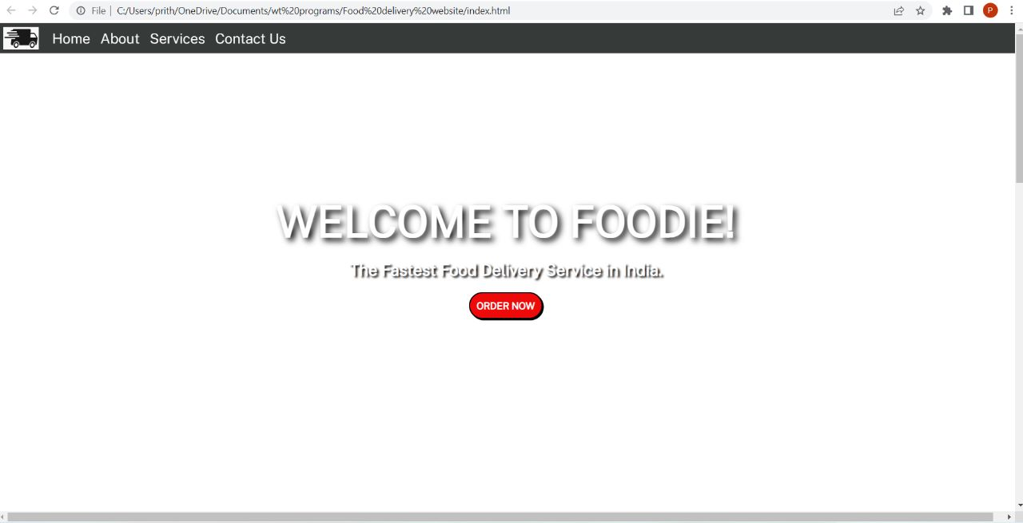

Slide 28
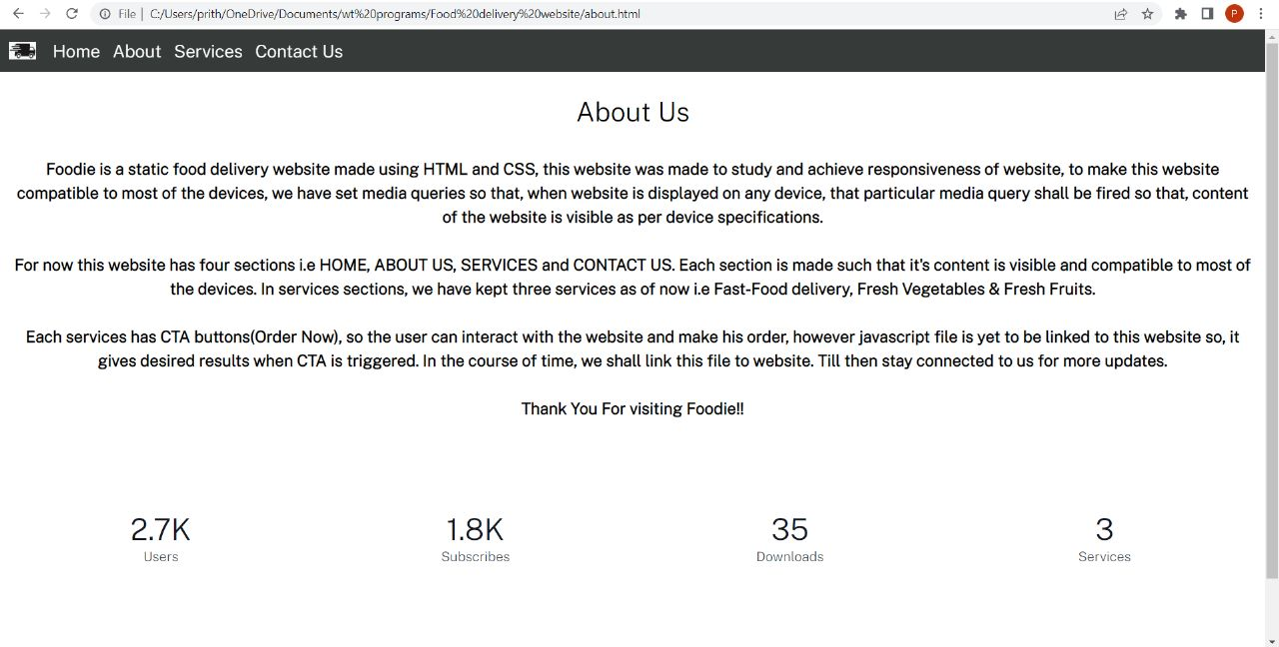

Slide 29
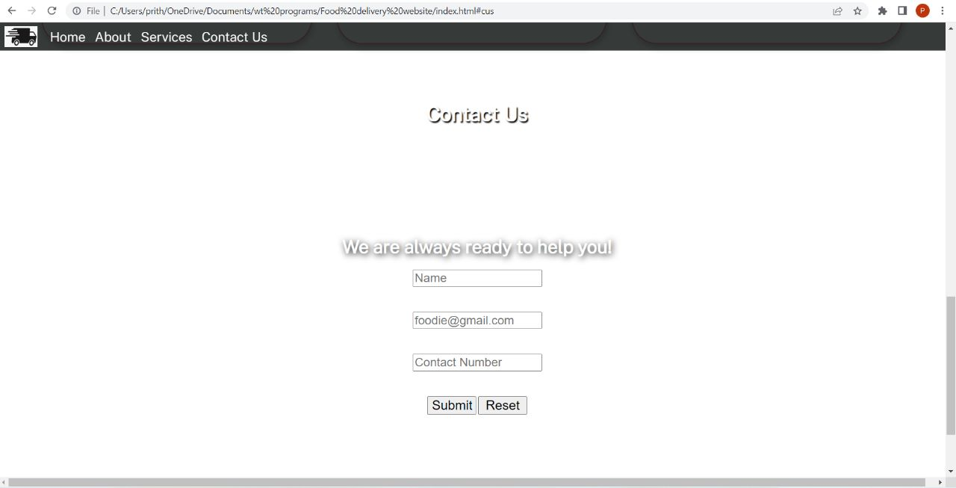

Slide 30
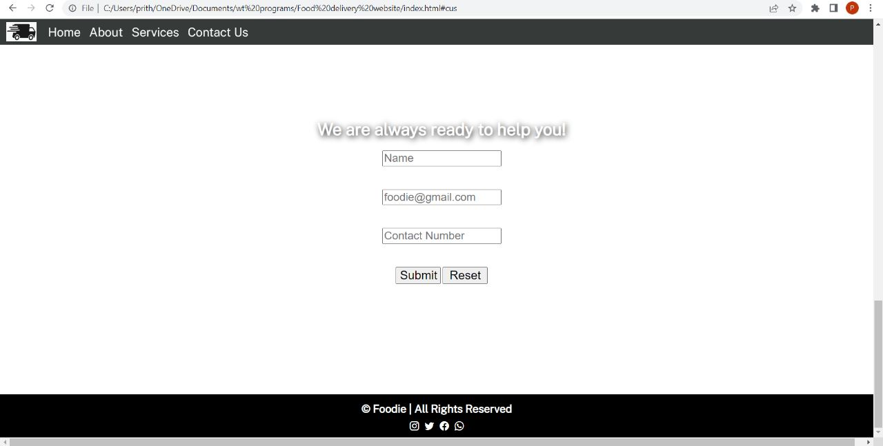

Slide 31
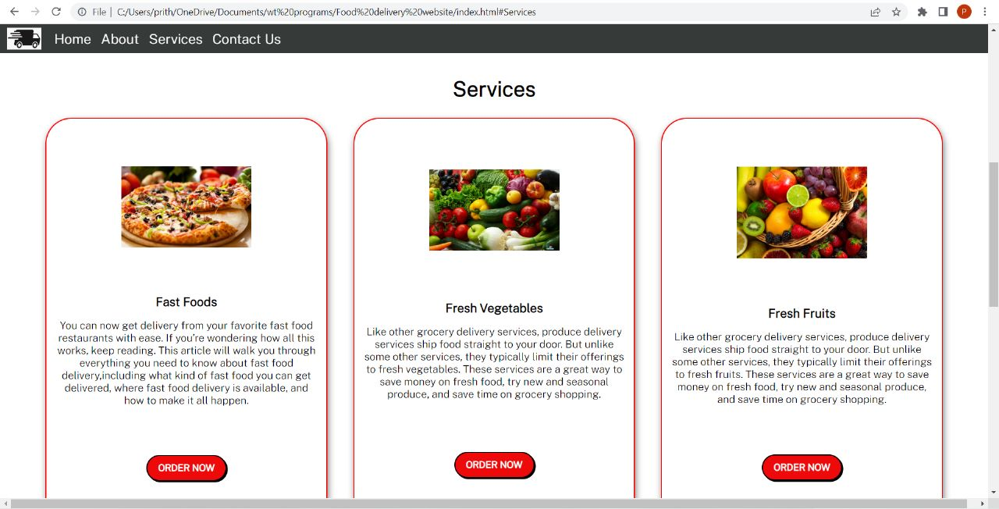

Slide 32
Submission Github
https://github.com/sundark14/ui-food-delivery-website.git

